Slide 1

Big Data Ecommerce Website
Anoop Nagaraj
Ansh Soni
Jaideep Sai Kalapatapu
Shashidhar Channabasavaraj

Slide 2
Components Used
NoSQL: Mongo DB
Search System: Elastic Search
Cache: Redis
CDN: Cloudinary
Application server: Nodejs
Front End: Angular

Slide 3







Architecture

Slide 4
Mongo DB for NoSQL
It is a schema-less database.
Sharding is the process of storing the data in different machines and MongoDB's ability to process the data which results in the horizontal scaling.
mLab used for fully managed cloud database service which hosted our MongoDB database.
Ideal for pay per use service model because it gurantees high data and server availability. Also it takes responsibility of disaster recovery and your data.

Slide 5
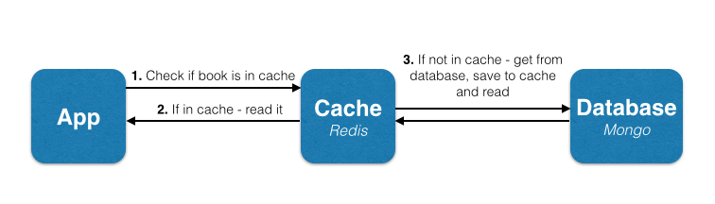
Redis Cache
Suitable for scalable Big Data applications
Deployed to Azure Redis cache for high throughput and consistent low latency data access.
Things like Data import/export, setting max memory policy and usage metrics has to be done manually unless you use Azure Redis-as-a-service.

Slide 6
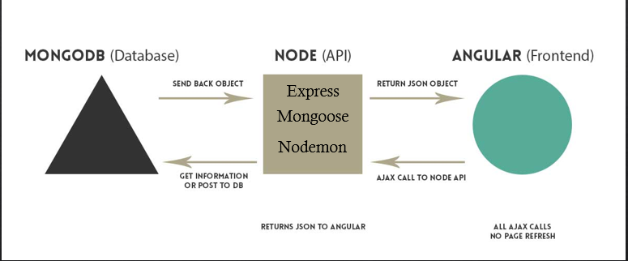
NodeJS
Node.js rules the real time web application world by using push technology over web sockets for creating server side web applications with two way connections- both client and server can initiate communication.
Deployed the web application to Azure which makes it even more light and efficient.
We have created the web.config file to deploy in Azure which is an XML document that resides in the root directory of the site or application and contains data about how the web application will act.

Slide 7
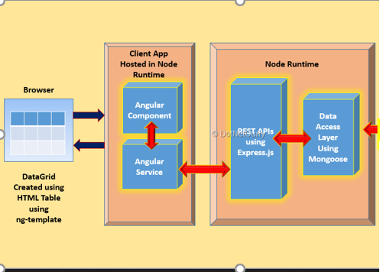
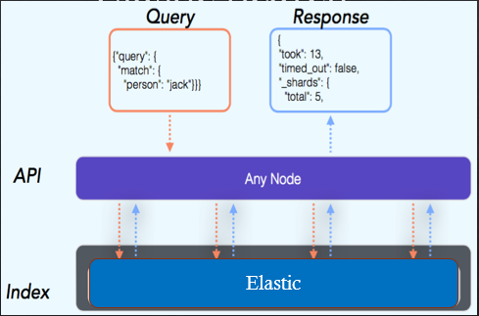
Angular
Elastic Search

